Slide 1
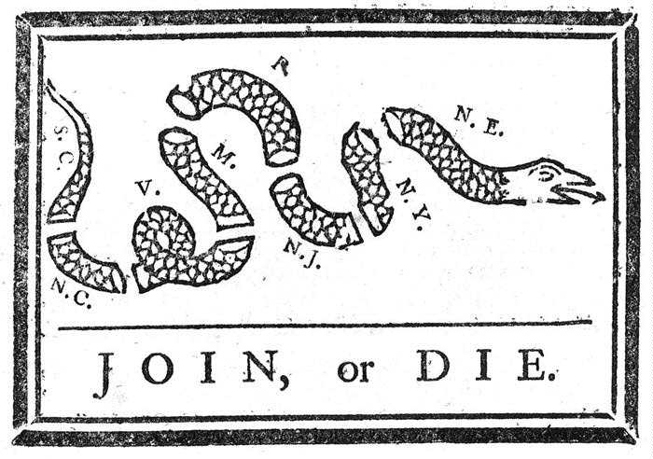
First in 1754 Again 1760s & 1770s

Slide 2
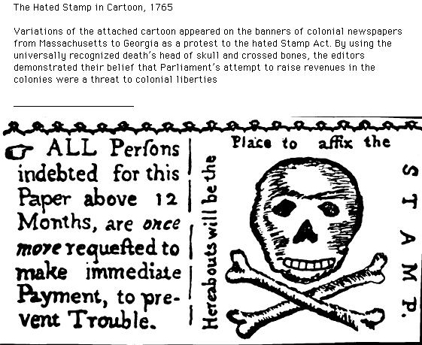
Stamp Act 1765

Slide 3
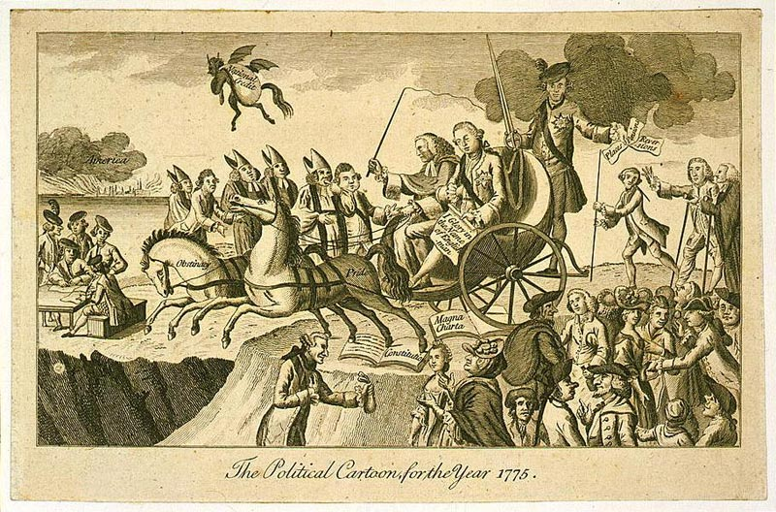
1775

Slide 4
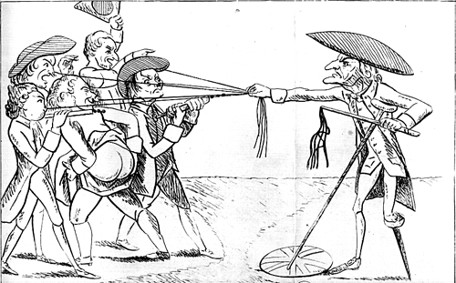
1773-75

Slide 5
War 1775-1783

Slide 6
The Critical Period: 1783-1789

